Slide 1
New Ideas for Stereo Matching of Untextured Scenes
TU Darmstadt, August 18, 2017
Daniel Scharstein
Middlebury College
This work is supported by NSF grant IIS-0917109

Slide 2
Joint work with
Sudipta Sinha, MSR
Tatsunori Taniai, U Tokyo
Dylan Quenneville ’18

Slide 3
Motivation
Huge progress in stereo over last 20 years …

Slide 4
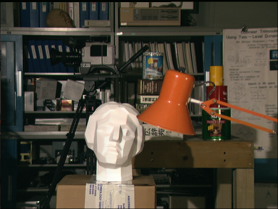
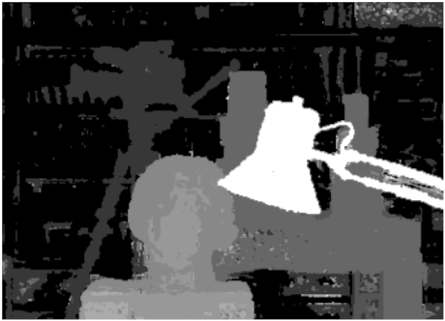
Motivation
Huge progress in stereo over last 20 years …
1990s
[Okutomi et al. 1996]

Slide 5
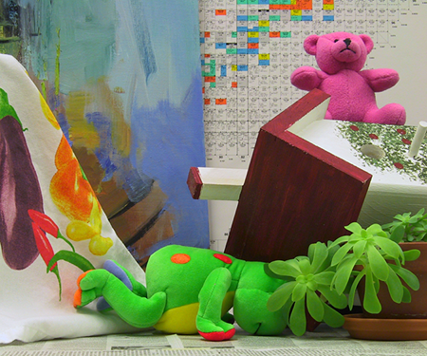
Motivation
Huge progress in stereo over last 20 years …
1990s … 2000s
[Bleyer & Gelautz 2004]

Slide 6
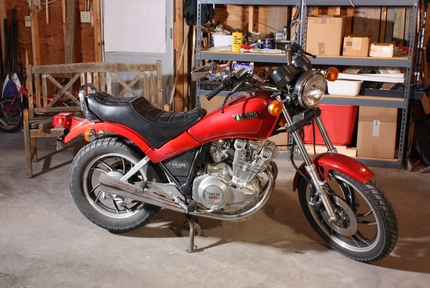
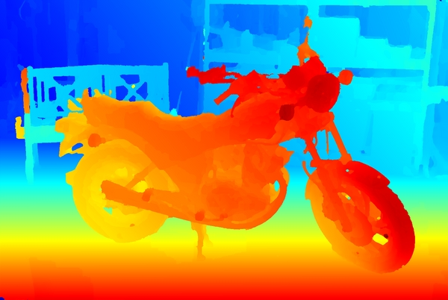
Motivation
Huge progress in stereo over last 20 years …
1990s … 2000s … 2017
[Taniai et al. 2017]

Slide 7
But –

Slide 9
Still Challenging:
Reflections
Transparency
Thin structures
High resolution
Limited computing resources
Untextured regions

Slide 10
Still Challenging:
Reflections
Transparency
Thin structures
High resolution
Limited computing resources
Untextured regions

Slide 11
Two Talks in One!
Semi-Global Stereo Matching with Surface Orientation Priors
D. Scharstein, S. Sinha, T. Taniai
Submitted to 3DV 2017
Mondrian Stereo
D. Quenneville and D. Scharstein
To appear at ICIP 2017

Slide 12
Part 1: SGM-P
SGM with surface orientation priors

Slide 13
SGM [Hirschmüller 2005]
Most successful practical stereo method

Slide 14
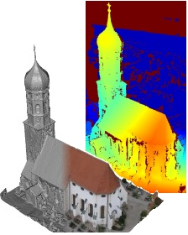
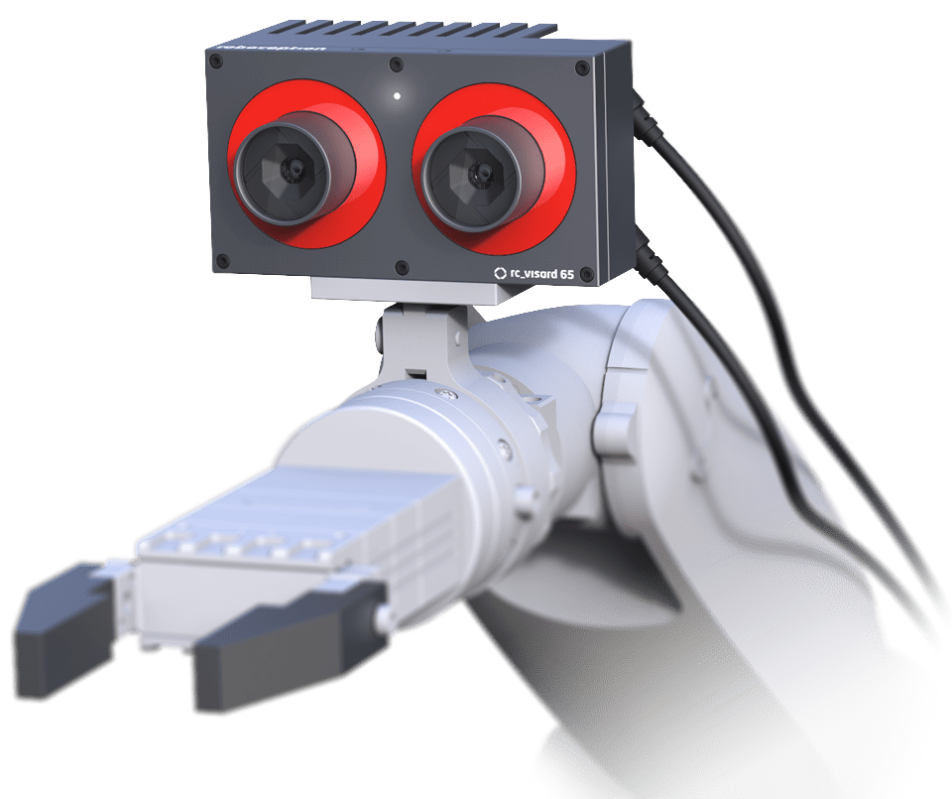
SGM [Hirschmüller 2005]
Most successful practical stereo method
Used in photogrammetry, assisted driving, robotics, …

Slide 15
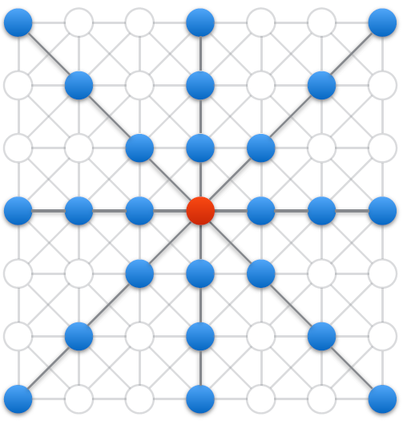
SGM
Approximates 2D MRF
using 1D optimization
along 8 cardinal directions
[Drory et al. 2014]

Slide 16
First-order smoothness
Problem: fronto-parallel bias
→ errors in untextured slanted regions

Slide 17
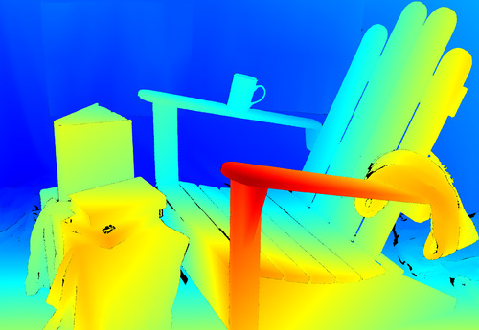
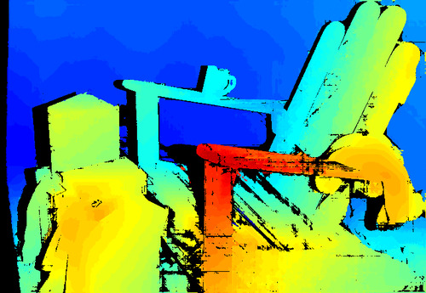
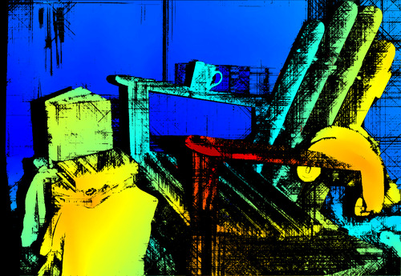
Example: Adirondack image pair
Left input image
GT disparities
SGM @ quarter resolution
SGM @ full resolution

Slide 18
SGM-P: SGM with orientation priors
What if we had hypotheses about surface slant?
Replace fronto-parallel bias with bias parallel to surface
Key idea:
rasterize disparity surface prior (at arbitrary depth)
adjust V(d, d’) to follow discrete “jumps”

Slide 19
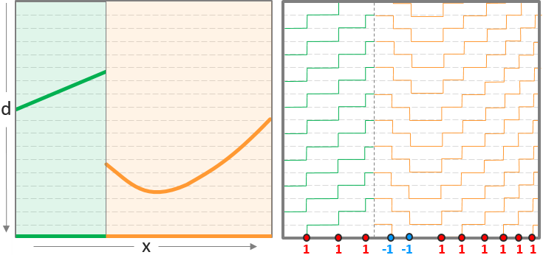
2D orientation priors

Slide 20
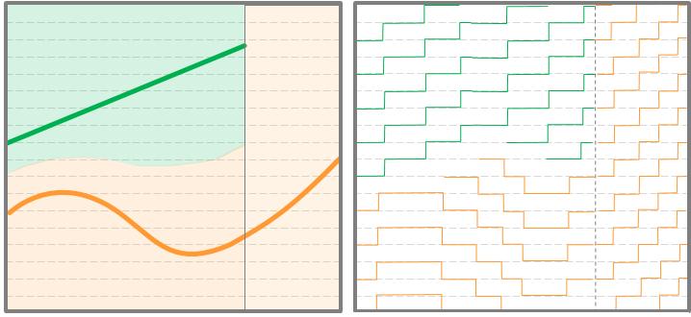
3D orientation priors
jumps depend on d

Slide 21
Where do we get priors?
Matched features + triangulation
Matched features + plane fitting
Low-res matching + plane fitting
Semantic analysis
Manhattan-world assumptions
Other sensors (depth cameras, …)

Slide 22
Where do we get priors?
Matched features + triangulation
Matched features + plane fitting
Low-res matching + plane fitting
Semantic analysis
Manhattan-world assumptions
Other sensors (depth cameras, …)
GT oracles

Slide 23
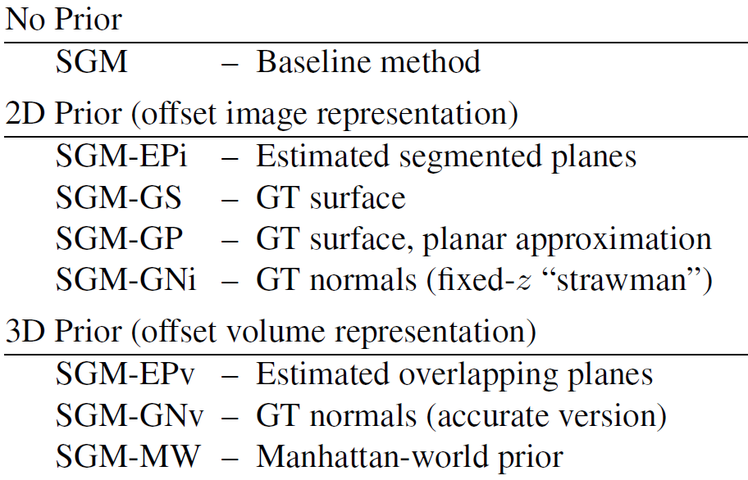
Algorithm variants

Slide 24
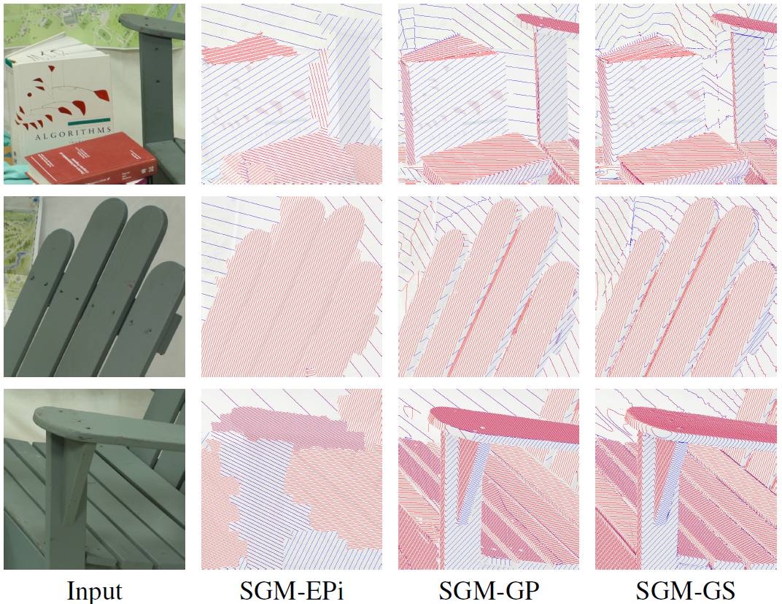

Slide 25
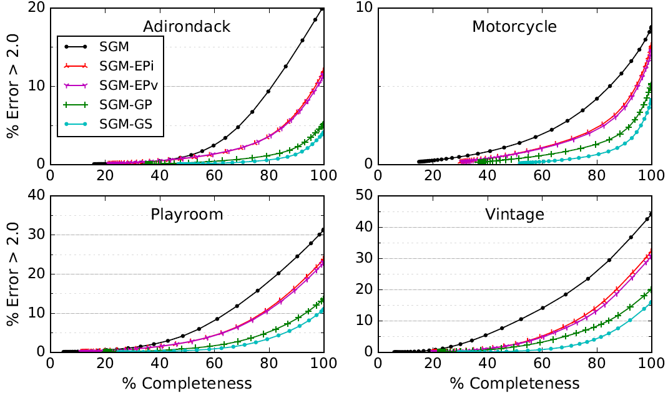
Results

Slide 26
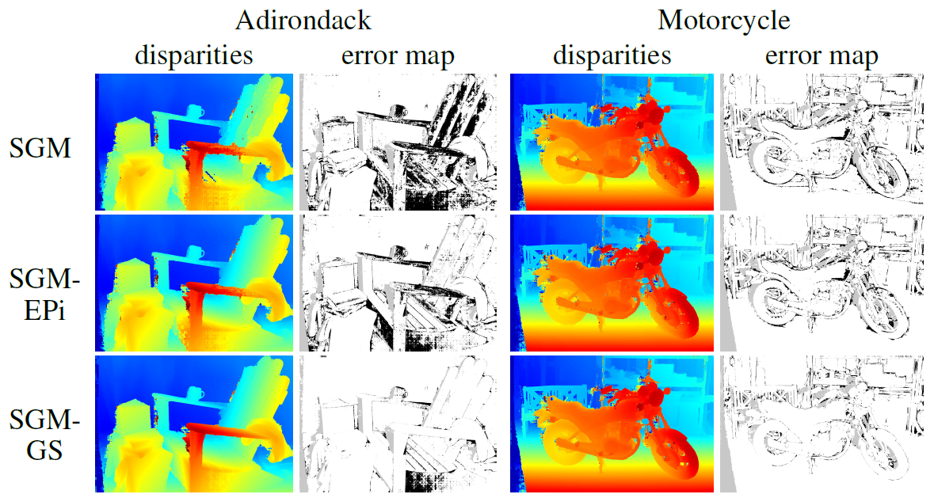
Results

Slide 27
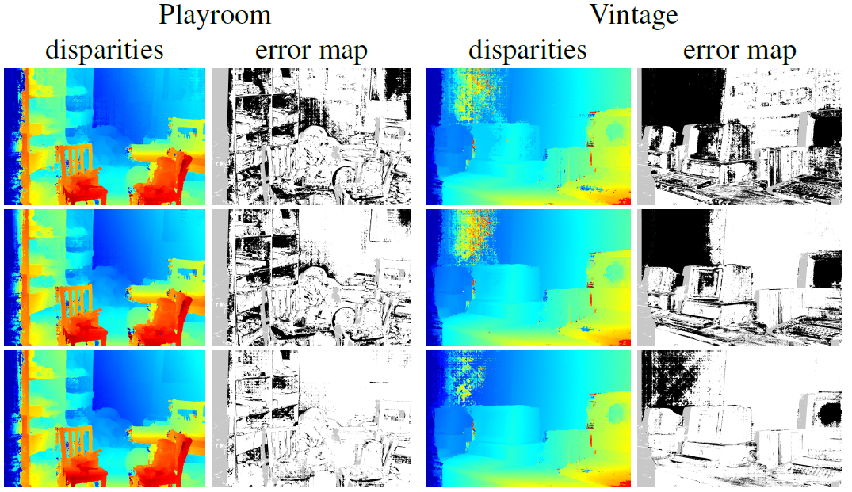
Results

Slide 28
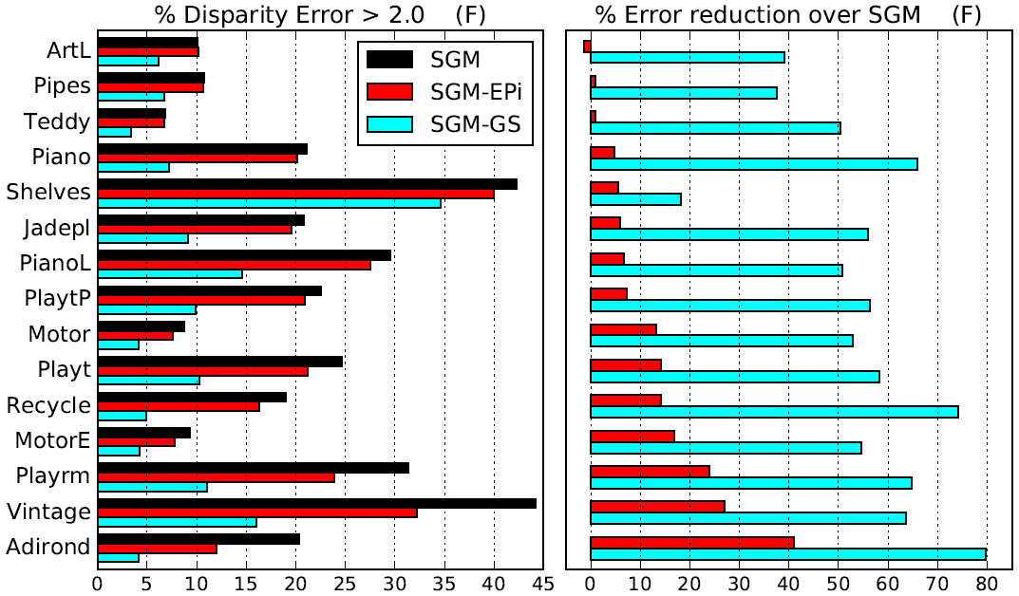
Results

Slide 29
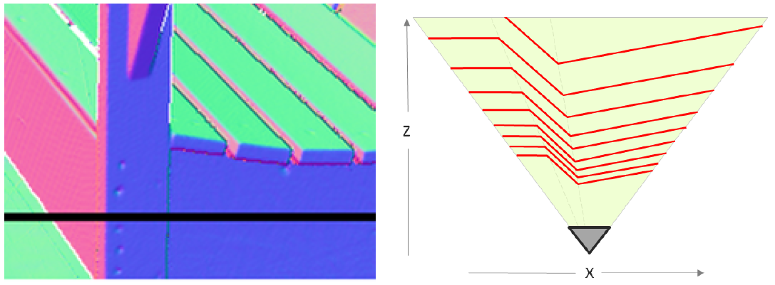
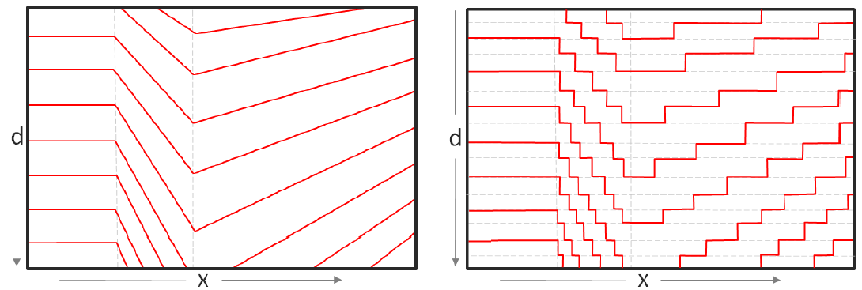
How about surface normal priors?

Slide 30
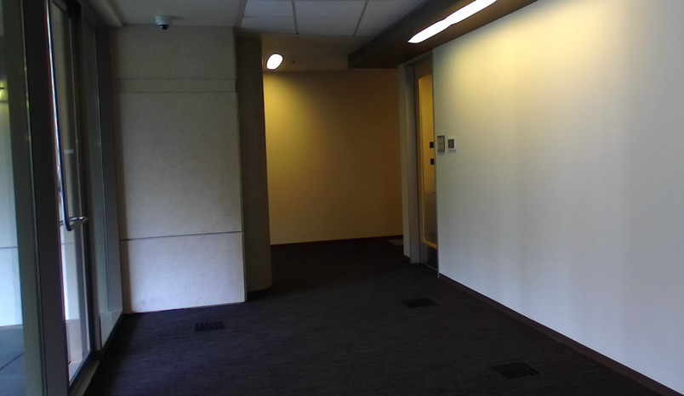
Manhattan-world priors
SGM
SGM-
EPi
SGM-
MW
Normal estimates [Lee et al. 2009]

Slide 31
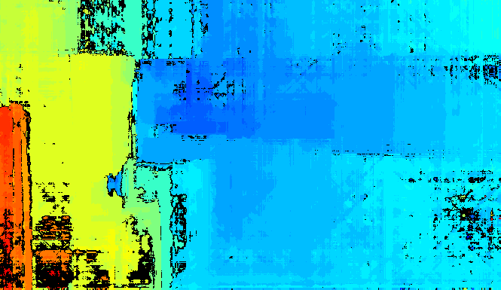
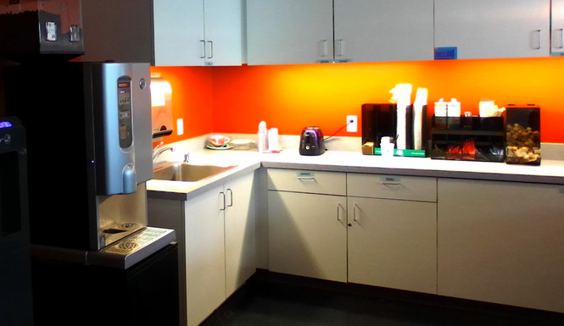
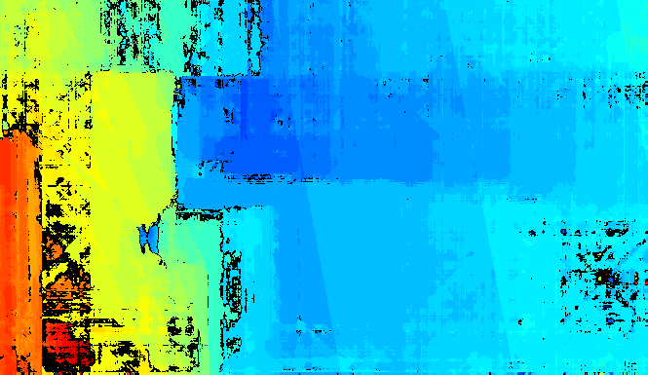
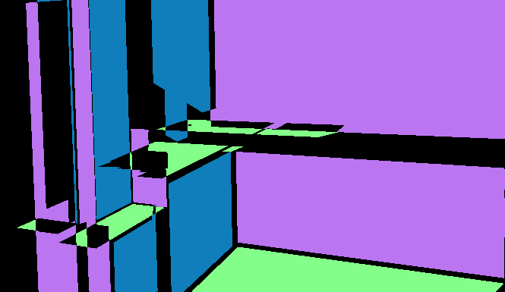
Manhattan-world priors
SGM
SGM-
EPi
SGM-
MW
Normal estimates [Lee et al. 2009]

Slide 32
SGM-P has minimal overhead

Slide 33
Summary (part 1)
Defined SGM-P, simple extension to SGM
Utilizes precomputed 2D or 3D orientation priors
Priors can be obtained in many ways
Soft constraint, doesn’t hurt performance
Huge performance gains for slanted untextured scenes
Minimal runtime overhead

Slide 34
Are better smoothness priors enough?

Slide 35
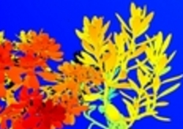
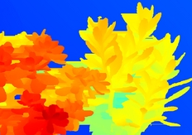
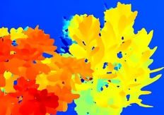
Plants L (zoomed)
GT (blurry)
3DMST
LW-CNN

Slide 36
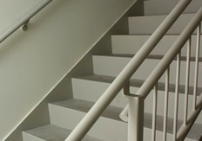
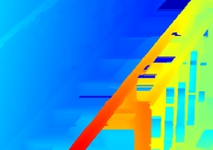
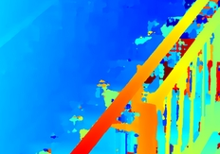
Staircase L (zoomed)
GT (blurry)
3DMST
LW-CNN

Slide 37
Are better smoothness priors enough?
→ Also need to reason about
segment color
occlusion

Slide 38
Part 2: Mondrian Stereo
What if the world is completely untextured?
Notes:
Google cardboard viewer: http://www.cs.middlebury.edu/~schar/mondrian/viewing-n.php

Slide 39
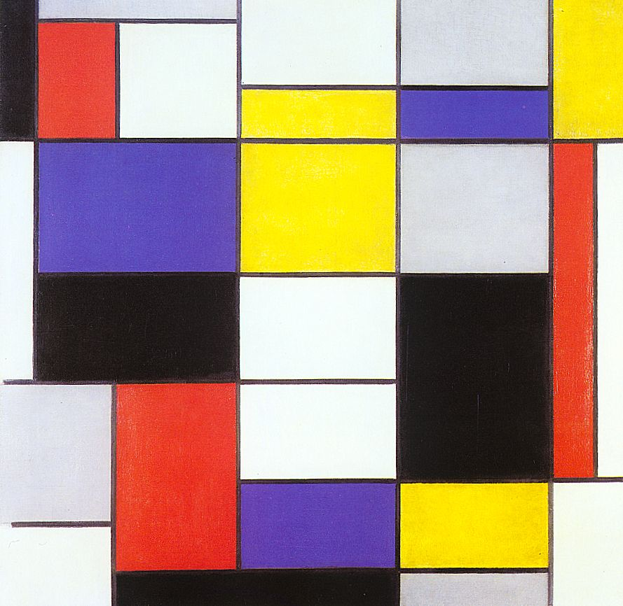
Piet Mondrian, Composition A, 1923

Slide 40
L

Slide 41
R

Slide 42
far
L
GT
close

Slide 43
far
R
GT
close

Slide 44
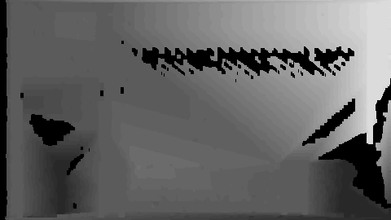
L
GT
SGM
ELAS

Slide 45
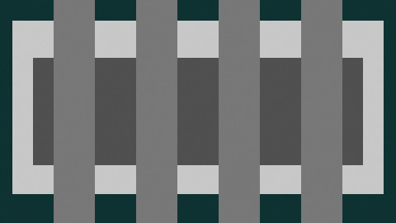
L
GT

Slide 46
R
GT

Slide 47
L
GT
SGM
ELAS

Slide 48
L
GT
SGM
ELAS

Slide 49
R
GT
SGM
ELAS

Slide 50
L
GT
SGM
ELAS

Slide 51
R
GT
SGM
ELAS

Slide 52
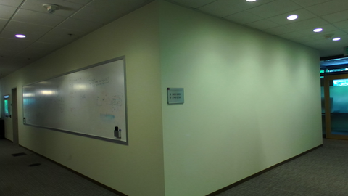
L

Slide 53
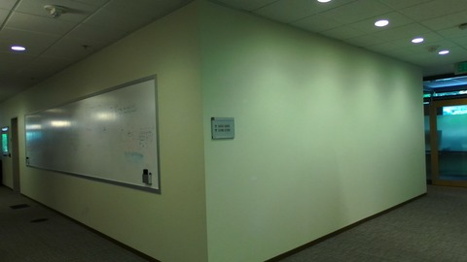
R

Slide 54
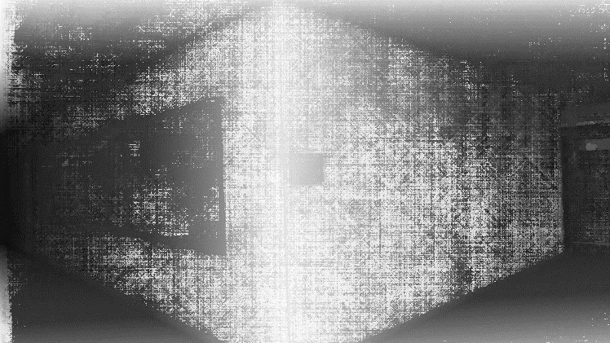
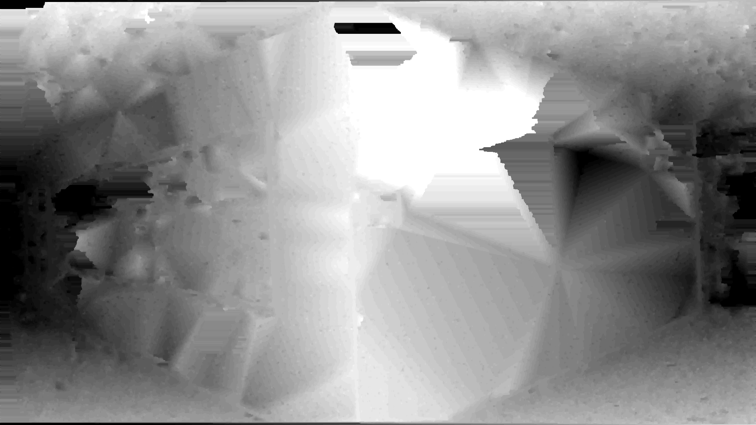
L
SGM
ELAS

Slide 55
L

Slide 56
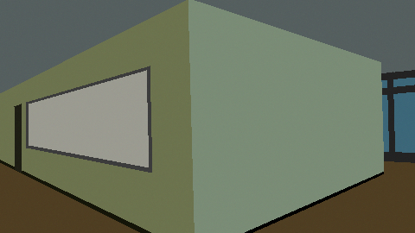
L

Slide 57
L
GT

Slide 58
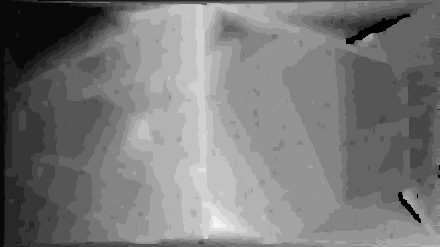
L
GT
SGM
ELAS

Slide 59
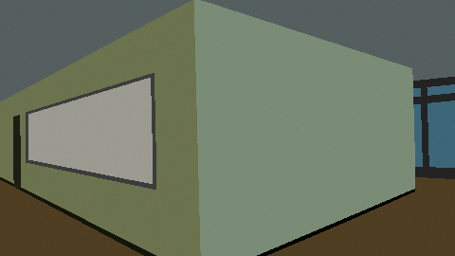
R
GT
SGM
ELAS

Slide 60
Mondrian Stereo
Can we write an algorithm to solve these “pathological cases”?
And if so, what can we learn that will help us improve real stereo algorithms?

Slide 61
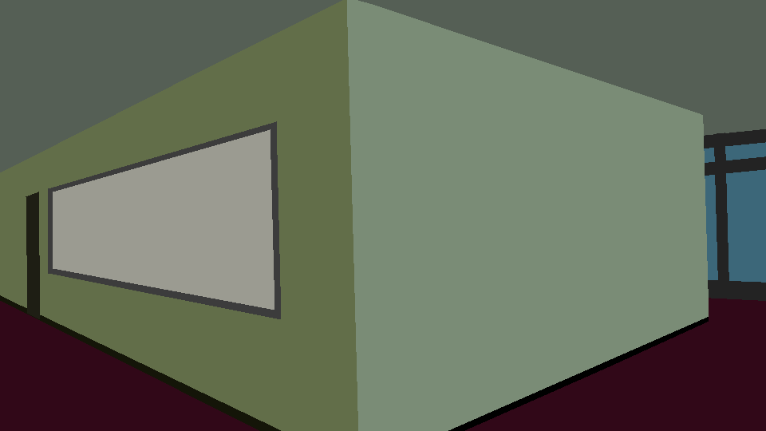
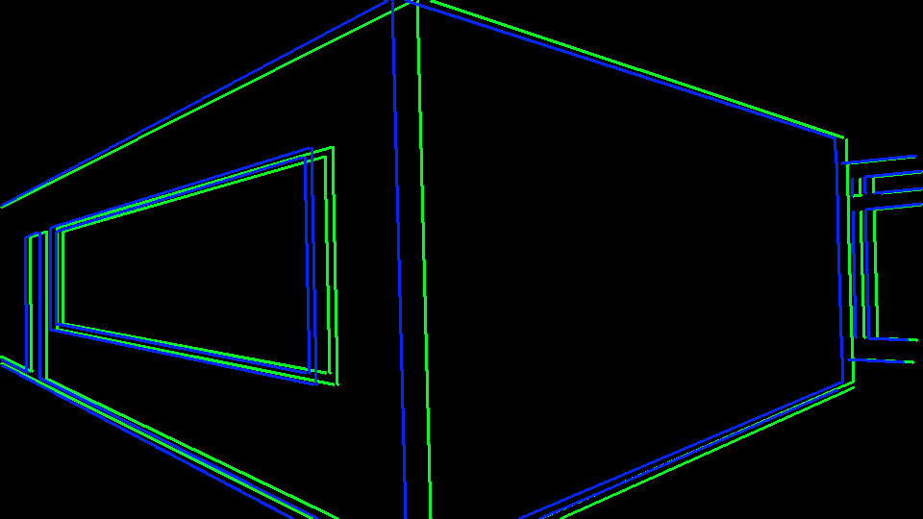
Algorithm
Compute color segmentation
Detect and match color edges
Fit planes to matched edges
Propose edge ownership

Slide 62
Edge Ownership
Edge is owned by both adjacent surfaces
Color edge
Surface crease
Edge is owned by only one surface
Occlusion (depth) edge
far
close

Slide 63
Edge Ownership
L
R
far
d
close
d
d

Slide 64
Resolving ambiguities
Assumption 1:
In the absence of other evidence, each surface is assumed to be as close as possible
far
d
close
d
d

Slide 65
Resolving ambiguities
Assumption 1:
In the absence of other evidence, each surface is assumed to be as close as possible
Assumption 2:
Prefer assigning disconnected segments with same color to same surface if valid occluder present
far
close

Slide 66
Algorithm, cont’d
Compute color segmentation
Detect and match color edges
Fit planes to matched edges
Propose edge ownership
Pass 1: use closest planes for each segment
Pass 2: merge segments, reassign planes
disconnected w/ same color, if occluder present
adjacent w/ different color, if compatible planes
[Optionally use texture for disambiguation]
Extend planes into unassigned segments

Slide 67
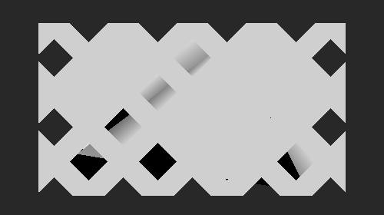
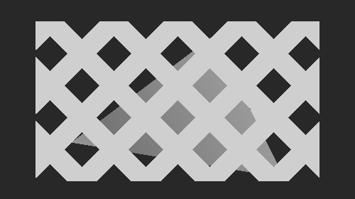
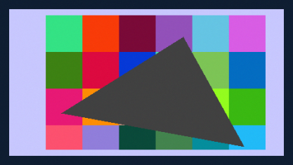
Results
L
ELAS
Pass 1
Pass 2
GT

Slide 68
Results
L
ELAS
Pass 1
GT
GT

Slide 69
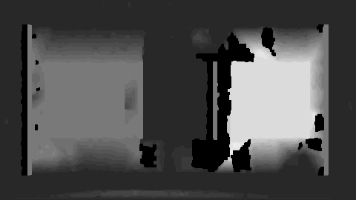
Results, cont’d
L
ELAS
Pass 1
Pass 2
GT

Slide 70
Results, cont’d
L
ELAS
Pass 1
GT
GT

Slide 71
Mondrian Stereo
Can we write an algorithm to solve these “pathological cases”?
And if so, what can we learn that will help us improve real stereo algorithms?

Slide 72
Towards “real” Mondrian Stereo
Avoid complex (yet insufficient) monolithic energy minimization
Use sequence of simpler minimization problems
First pass: “closests surfaces”
Identify untextured segments
“Push back” to farther surface with color and occlusion reasoning

Slide 73
Summary (of both parts)
Long-term goal: Efficient, scalable, robust stereo
Avoid enumerating all depth hypotheses
Quickly solve “easy” portions
Employ smart priors
Identify mistakes, backtrack
Explicit reasoning about untextured regions and occlusion

Slide 74
Conclusion
Stereo is not a solved problem!

