Slide 1
Panel:
NSF-Sponsored Innovative Approaches to Undergraduate Computer Science
Stephen Bloch (Adelphi University) Amruth Kumar (Ramapo College)
Stanislav Kurkovsky (Central CT State University) Clif Kussmaul (Muhlenberg College)
Matt Dickerson (Middlebury College), moderator

Slide 2
Project | Web site(s) | Intervention | Delivery | Supervision
Program by Design Stephen Bloch NSF awards 0010064 & 0618543 | http://programbydesign.org http://picturingprograms.org http://www.ccs.neu.edu/home/matthias/HtDP2e/ http://racket-lang.org http://wescheme.org | curriculum with supporting IDE, libraries, & texts | in class; software and textbook are free downloads or web-based | normally active, but can be done other ways
Problets Amruth Kumar NSF award 0817187 | http://www.problets.org | in- or after-class problem-solving exercises on programming concepts | applet in a browser | none - teacher not needed, although some adopters use it in active mode too
Mobile Game Development Stan Kurkovsky NSF award DUE-0941348 | http://www.mgdcs.com/ | in-class or take-home programming projects | PC | passive - teacher as facilitator to answer Qs
POGIL Clif Kussmaul NSF award TUES 1044679 | http://pogil.org http://cspogil.org | in-class activity | paper or web | passive - teacher as facilitator to answer Qs

Slide 3
Project | Course(s) | Language(s) | Focus
Program by DesignStephen Bloch | Middle school, pre-AP CS in HS, CS0, CS1, CS2 in college | Usually Scheme-like teaching languages leading into Java; has also been done in Python, ML, Java, Scala, ... | problem-solving process, particularly test-driven development and use of data types to guide coding & testing
Problets Amruth Kumar | AP-CS, CS I, CS 2. also as refresher or to switch languages in other courses | C, C++, Java, C# | code tracing, debugging, expression evaluation, predicting program state
Mobile Game DevelopmentStan Kurkovsky | AP-CS, CS1, CS2 | Java | core OO programming; intro to advanced subjects such as AI, networks, security
POGILClif Kussmaul | CS1, CS2, SE, etc. CS Principles (HS) (used across STEM) | often concept-based and language-independent; CS1 in Java & Python | knowledge construction, process skills

Slide 4
 | Teacher |  |  | Students
Project | prep before class | during class | after class | # | during | after
Program by Design Stephen | select examples | model problem- solving process; answer questions | feedback to students: how well did they follow the process? | solo or small team | mostly programming
Problets Amruth | sign up to get URL; specify which problet to use when | none; not even in supervised mode | use report to select concepts to review in class | solo | solving problems on programming
Mobile Game Develop- ment Stan | become familiar with the technical scaffolding provided by each project and with sample solution | explain objectives, demonstrate sample solution, help students with scaffolding | review completed programming projects | teams of 2 | working on programming project
POGIL Clif | make copies or post. (writing activities is time intensive) | facilitate teams, share conclusions | review team reports | teams of 2-4 | working through activity | summary report (optional)

Slide 5
Program By Design
Stephen Bloch, Adelphi University
with Eli Barzilay, John Clements, Matthias Felleisen, Robby Findler, Kathi Fisler, Matthew Flatt, Kathy Gray, Shriram Krishnamurthi, Viera Proulx, Emmanuel Schanzer, ...

Slide 6
Curricular ideas
Start in simple, beginner-friendly language
need beginner-friendly IDE & compiler
Teach fundamental, transferable principles & habits
Test-driven development from the beginning
need beginner-friendly testing harness
Graphics, animation, GUI, music as motivators
need beginner-friendly libraries
Then revisit same ideas in “mainstream” language (next semester or next year)

Slide 7
Pedagogical ideas
Concrete design recipe
Identify input & output data types
Write test cases (guided by data types)
Write function skeleton (guided by data types)
Fill in gaps (guided by test cases)
Run test cases
Each step is explicit & worth partial credit
Writing test cases is much easier for functional than imperative code, so start in functional paradigm
even for graphics & interaction
Functional GUI programming teaches model/view separation early

Slide 8
Technical ideas
Start in language subset…
enforced by compiler
Several concentric languages matching stages of curriculum
Read-eval-print loop to encourage experimentation
like DrJava, BlueJ CodePad, irb, python, ghci, etc.
“Image” is a data type, just like “integer” or “string”
even in the REPL
Can enter an image as a literal, interactively
Can see images as expression values, interactively
Demo: http://screencast.com/t/12O3RGxFH

Slide 9
Versions of the curriculum
Bootstrap (middle school)
http://bootstrapworld.org
Picturing Programs (high school pre-AP, college CS0)
http://picturingprograms.org
How to Design Programs 2ed (college CS1)
http://www.ccs.neu.edu/home/matthias/HtDP2e/
or search “htdp2e”

Slide 10
Software support
WeScheme (IDE in a browser, used with Bootstrap)
http://wescheme.org
DrRacket (IDE, used with PP and HtDP)
http://racket-lang.org
JavaLibWorld and JavaLibTester (support libraries for Java-based course)
search on GitHub

Slide 11
Who likes this approach?
Grants from Exxon, DoEd, NSF, Google
ACM SIGCSE “Outstanding Contribution to Computer Science Education” award (2011)
ACM Karlstrom award (2009)

Slide 12
Who uses this approach?
Bootstrap:
Park Elementary School NYOS Charter School
Ballou High School Boston Latin Academy
Edison Middle School United for Success Academy
Yanbu International School Barnard Saturday Science Seminar
Crossroads School St. Andrew's-Sewanee School
Sedro-Woolley High School Academy for Science and Design
Albuquerque Academy International School Ho Chi Minh City
124 more omitted

Slide 13
Who uses this approach?
Picturing Programs:
University of Toronto
University of California, Irvine
Vassar College
Adelphi University
Georgia Regents University
Indian Institute of Information Technology and Management-Kerala, Trivandrum, India
St Francis Borgia HS
Whitney Young HS
The Fay School
Lakehill Preparatory School
Aberdeen HS
Holy Name HS
Owatonna HS
Bancroft School
Dighton-Rehoboth HS
Augusta Preparatory Day School
Nashoba Regional High School
St Luke’s School
The Webb Schools
oxfordcomputerscience.wikispaces.org (HS level)
DuPont Manual HS (in Scala?)
Evergreen Middle School
at least one 4th-grade teacher (!)
various others omitted

Slide 14
Who uses this approach?
How to Design Programs
University of Chicago
Northeastern University
University of Delaware
Westmont College
Worcester Polytechnic Institute
University of Notre Dame
University of Waterloo
Istanbul Bilgi University
Seton Hall University
Berry College
Brown University
Monmouth College
University of Minnesota Morris
Northwestern University
Suffolk County Community College
University of British Columbia (both traditional course and MOOC)
Zefat Academic College
UNAM
Manhattanville College
Rhode Island College
University of Tübingen
University of Freiburg
University of Dallas
South Carolina State University
Pacific Union College
Humboldt College
University of Chile (in Python)
Ochanomizu University (in OCaML)
Carnegie-Mellon (in ML)
various others omitted

Slide 15
Problets
Amruth Kumar,
amruth@computer.org
problets.org

Slide 16
Curricular Goals
Learn programming concepts by solving problems
Supplement classroom instruction
Complement programming projects

Slide 17
What Problets do:
Present problems
Grade student’s answer
Provide instant feedback
Record student performance
Provide summary to the instructor

Slide 18
Types of problems
Identify the output of a program
Debug a program
Resolve the state of program variables
Evaluate expressions
::
Step-by-step
Not multiple-choice problems

Slide 19
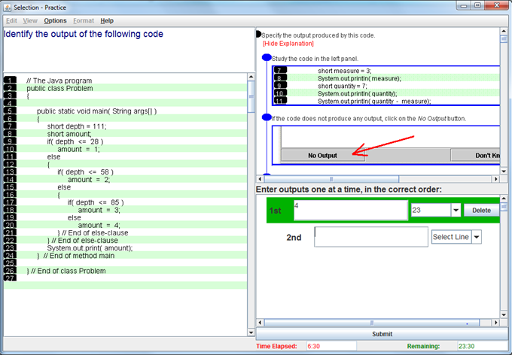
Identifying the output

Slide 20
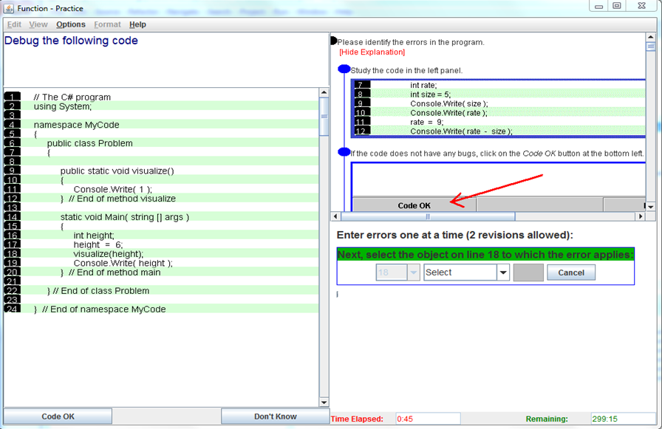
Debugging

Slide 21
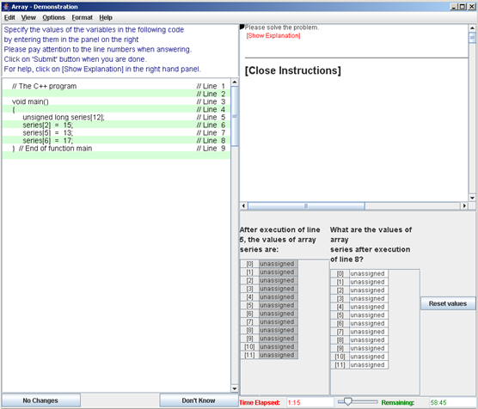
State of a variable

Slide 22
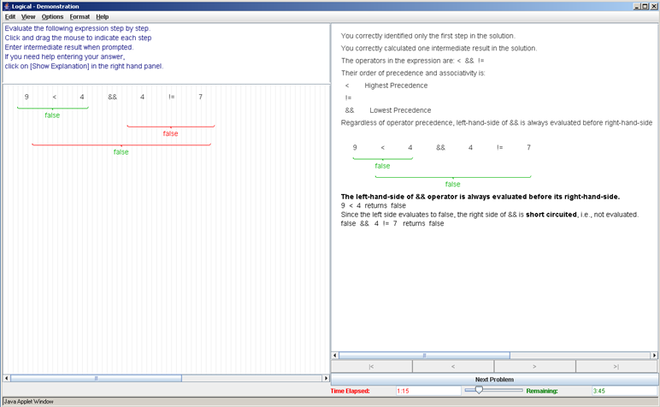
Expression Evaluation

Slide 23
Topics (17 modules)
Expression evaluation
Arithmetic, Relational, Logical, Assignment, Bitwise
Selection
if, if-else, switch, nested statements
Loops
while, for, do-while, nested loops, infinite loops
Functions - behavior, bugs, recursion
Arrays, Access in Classes, C++ pointers

Slide 24
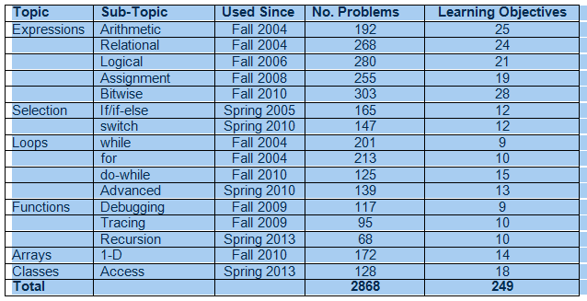
Topics and Problems

Slide 25
Target
Languages:
Java, C, C++, C#, some Visual Basic
Audience:
CS I, CS II, AP-CS
Refresher for advanced courses/language change
Institutions:
High school, 2-year, 4-year colleges

Slide 26
Pedagogy
Learn by solving problems
Mastery learning
Step-by-step explanation of correct solution
Adaptive problem-sequence
Randomized problem set
Learning at one’s pace on one’s time
Any time, as often as necessary
Extensively evaluated over 14 years

Slide 27
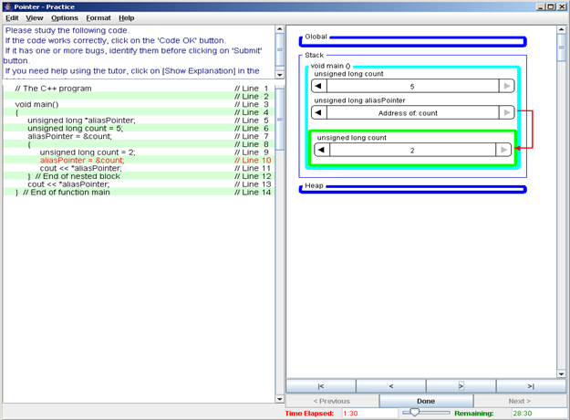
Visualization

Slide 28
Usage
Closed-Lab exercises
After-class assignments (24 x 7)
Language refreshers
As many as necessary
When necessary
As often as necessary
Continuous third-party use since fall 2004
60+ schools in spring 2014

Slide 29
Adoption
No software installation necessary - Web-based
No supervision necessary - self-administering
Report available on demand
By problems, learning objectives
Free for educational use

Slide 30
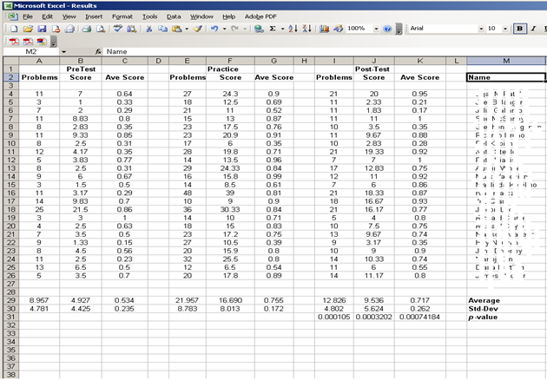
Snapshot of a report

Slide 31
Contact Information
Additional information at:
www.problets.org
If interested, please contact:
amruth@ramapo.edu
Acknowledgements: NSF CCLI DUE 0088864

Slide 32
Mobile Game Development
Stan Kurkovsky Central Connecticut State University
http://www.mgdcs.com/
with Archana Chidanandan and Delvin Defoe

Slide 33
Overarching Goals
Improve student engagement and motivation
Decrease attrition in introductory CS courses
Method: use a relevant learning context

Slide 34
Curricular Objectives
Expose students to advanced topics
Strengthen student mastery of the core concepts
CS is more than just coding!
Method: project-based learning modules

Slide 35
Learning Modules
Context
A well-known game (arcade, board, etc.)
Casual games
Learning objectives
Introduce an advanced topic (e.g. networking)
Reinforce a core topic (e.g. for loops)
Game implementation
Working demo
Technical scaffolding

Slide 36
Target
Language
Java: J2ME, Android
Audience
AP-CS, CS I, CS II
Also: advanced topical courses
Institutions
High school, 2- and 4-year colleges

Slide 37
Pedagogy
Context-based learning
Relevance to everyday life
Hands-on experiences
Teamwork
Instant gratification

Slide 38
Sample Modules
Battleship - computer networking
Connect Four - artificial intelligence
Frogger - software engineering
Space Bears - human-computer interaction
Craps - security
Text Twister - algorithms

Slide 39
Process Oriented Guided Inquiry Learning
(POGIL)
Clif Kussmaul, Muhlenberg College
http://cspogil.org http://pogil.org

Slide 40
POGIL - Curricular Goals
Across CS (& other STEM) disciplines, we should help our students learn to:
analyze, design, synthesize ideas
read, write, & debug code & docs
communicate (oral & written)
work in teams, manage time
learn or create ideas on their own

Slide 41
POGIL - Pedagogy
Research shows that learning is improved when people:
work in teams with other people
construct knowledge through a learning cycle (explore, invent, apply)
receive prompt constructive feedback
reflect on learning process & outcomes

Slide 42
Process Oriented Guided Inquiry Learning
Students work in teams with assigned roles(e.g. manager, recorder, speaker)
Teams work on classroom activities that present a model followed by questions.
Instructor is a facilitator, not a lecturer.
Activities are designed to guide students to:
construct understanding of key ideas
develop key process skills

Slide 43
POGIL Example: 1st Day of CS1
Hi-Lo: Guessing Game
Two players – A and B.
A picks a number 1-100.
B guesses a number.
A responds “too high”, “too low”, or “you win”.
Continue to play until B wins (or gives up).
Questions
Play the game 3 times.
Identify 4-5 strategies B could use to play.
(Discuss with class.)
Rank by # of guesses.
Rank by difficulty.
Plot rankings & describe.
(Discuss with class.)

Slide 44
POGIL Example: 1st Day of CS1
Strategy | S | D | Max | Avg
Random | 4 | 1 | 100 | 50
Count up by 1. | 3 | 2 | 100 | 50
Count up by 10, down by 1. | 2 | 3 | 20 | 10
Split range in ½ each time. | 1 | 4 | 7 | 6
Questions
Max # of guesses?
Avg # of guesses?
(Discuss with class.)
Repeat for 1-1000.
Repeat for any N.
Describe insights.
(Discuss with class.)

Slide 45
CS-POGIL cspogil.org
NSF TUES project (2011-2014) to develop POGIL materials for CS
CS2, Data Structures, Software Engineering
sci comp, CS1 (Java, Python), theory, AI, ...
Numerous CS collaborators, including:
Helen Hu, Lisa Olivieri, Matt Lang, Chris Mayfield, Heidi Ellis, Stoney Jackson, Tammy Pirmann
$$$ available to attend POGIL workshops

Slide 46
The POGIL Project pogil.org
Non-profit to support use of POGIL & related approaches
Long history of NSF funding (15+ years)
3-day regional summer workshops
Review POGIL activities, support classroom implementation

Slide 47
POGIL - Implementations
Students: 10-200; HS, undergrad, grad
Models: UML, Code, API doc
Media
Paper copies for each team or student
Google Doc for each team
Presentation slides
Team structure
Teams of 4, split for pair programming
Teams of 3

Slide 48
DISCUSSION
What might the approach not accomplish or do well?
When would you not use it as opposed to when would you use it?
How would your approach combine well with another of the approaches outlined here?

